Slide 1
MMAI 894 Deep Learning RF-Based Fall Monitoring Using Convolutional Neural Networks
Master of Management in Artificial Intelligence
18 Dec 2018
Notes:
1

Slide 2
Introduction
THE PAPER
Introduces the first ever CNN architecture for RF Based fall detection
CURRENT TECHNOLOGY & FALLS PROBLEMS
Increased falls related injuries; Existing devices not effective
ARCHITECTURE
Convolutional Neural Network (ResNet)
MODEL EVALUATION
Comparison with three baselines models i.e. LSTM, SVM and Kernel SVM
MAJOR ACHIEVEMENTS
Major achievements of the architecture
GAPS AND POTENTIAL USE CASES
Applications of the architecture

Slide 3
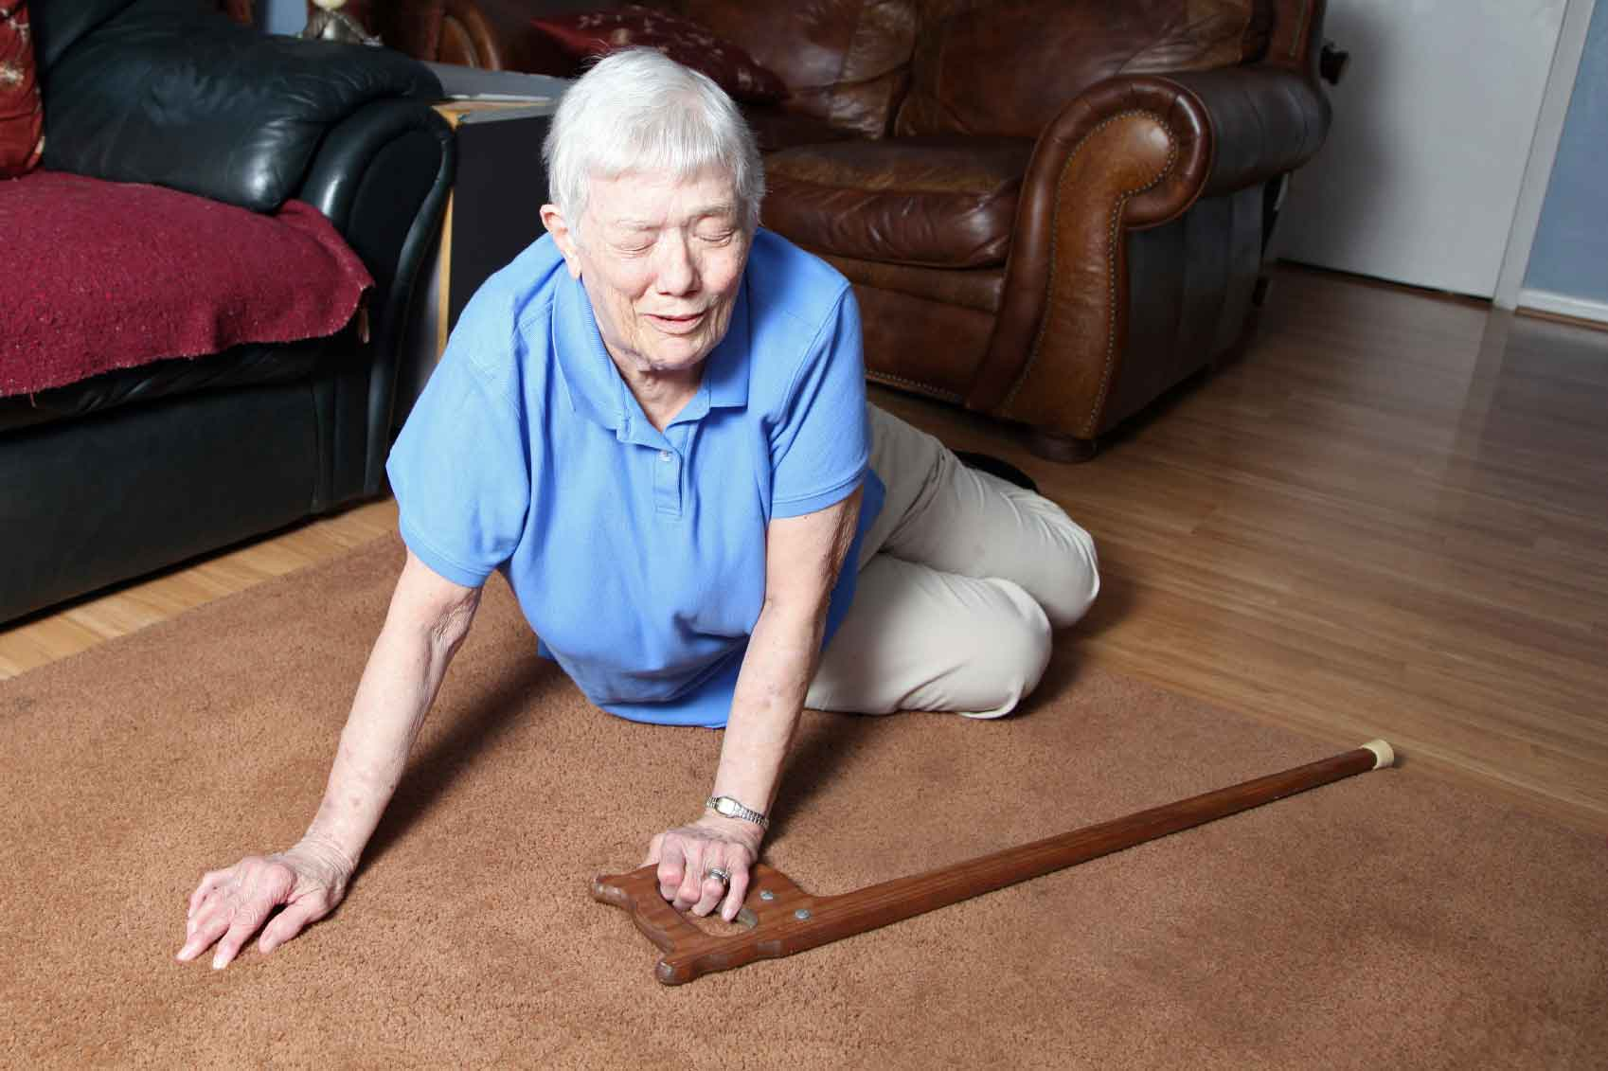
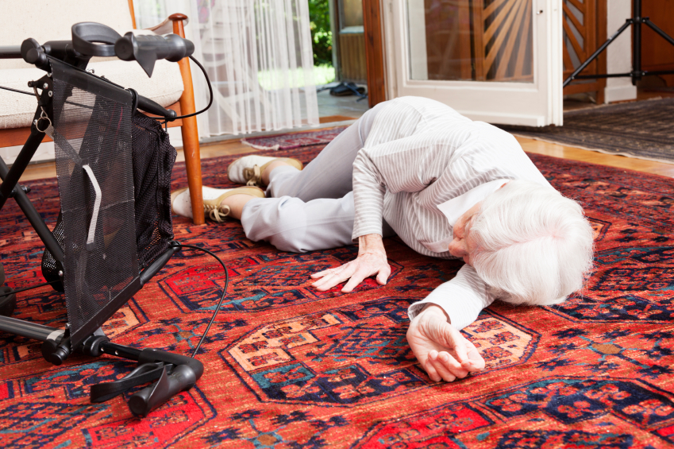
The Problem
Seniors fall
Top reason for fatal and non-fatal injuries among seniors
299,769
No. of Fall-related injuries for Canadians (> 65 yrs) increased from 49.4% to 58.8% between 2005 and 2013
Falls in 2013
Fall detection systems that alert the network of caregivers or family members; Can potentially save lives
Can we accurately detect falls?
https://www.bristol.ac.uk/news/2016/january/parkinsons-dementia-falls.html
https://blog.mavencare.com/home-care-resources/2015/11/hip-fracture-a-fate-worse-than-death

Slide 4
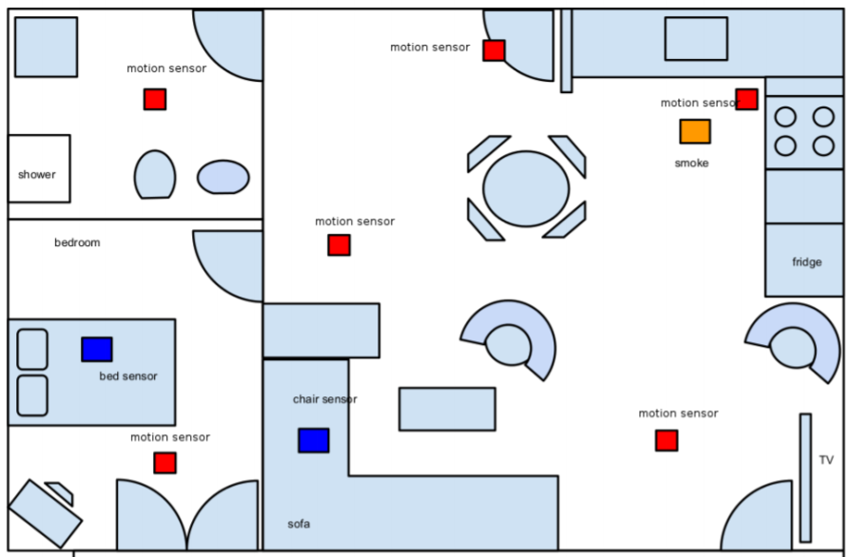
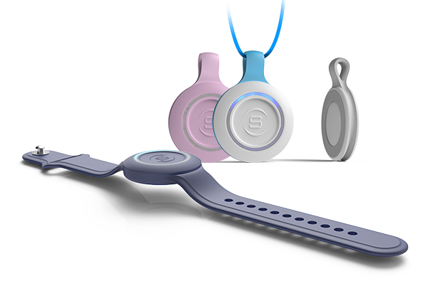
Existing Solutions in the Market
Wearable tech
Non-Wearable tech
*RSSI RF sensors *Doppler Radar *Wifi CSI-based
Challenges?
Wearables are ineffective, mostly because seniors do not wear them
Low accuracy
Cannot detect complex fall patterns
Cannot separate different sources of motion
Requires re-training at new environment
Do we have a better solution?
“Aryokee”
First Convolutional Neural Network based architecture for RF-based Fall Detection
Can identify complex Falls and fast Non-Fall motions
Separates a Fall from other motions in the environment
http://www.skynethealthcare.com/solutions/wearable-tech/
http://www.idiap.ch/~gatica/publications/AranSanchezDoGatica-hbu16.pdf

Slide 5
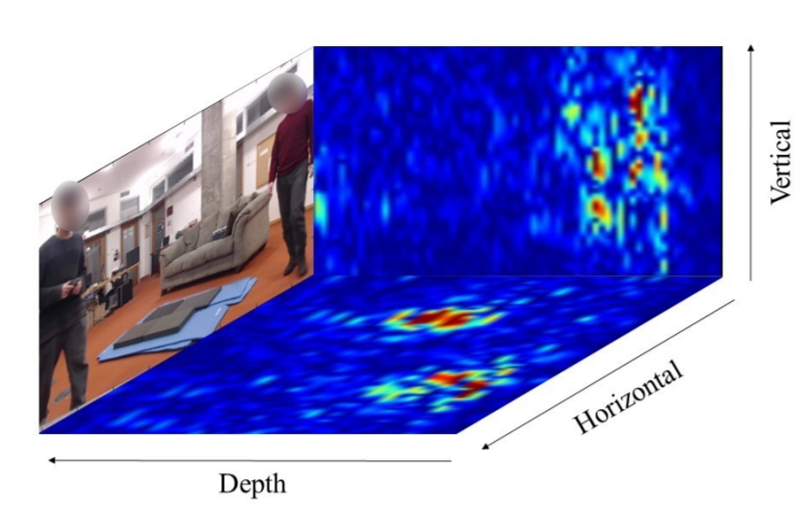
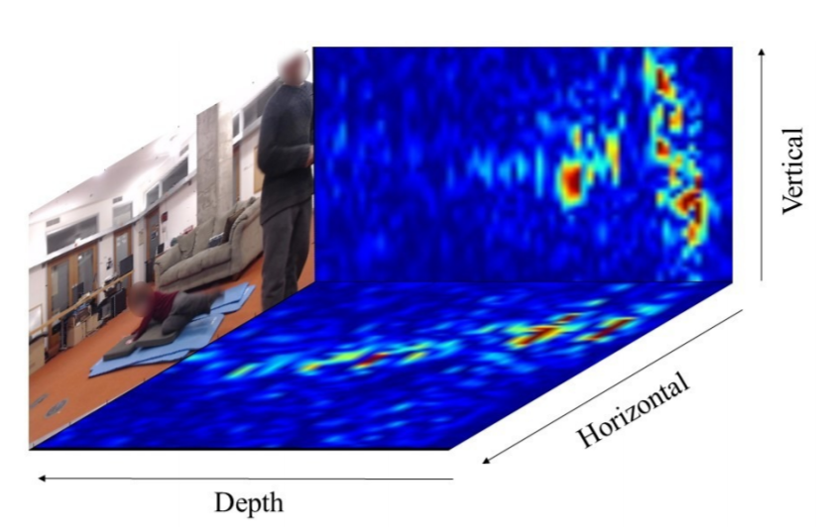
RF Signal Capturing in 3D
Vertical Heatmap
Elevation of the Person
Non-Fall
Non-Fall
Fall
Horizontal Heatmap
Location of the Person
Ref: Proc. ACM Interact. Mob. Wearable Ubiquitous Technol., Vol. 2, No. 3, Article 137. Publication date: September 2018.

Slide 6
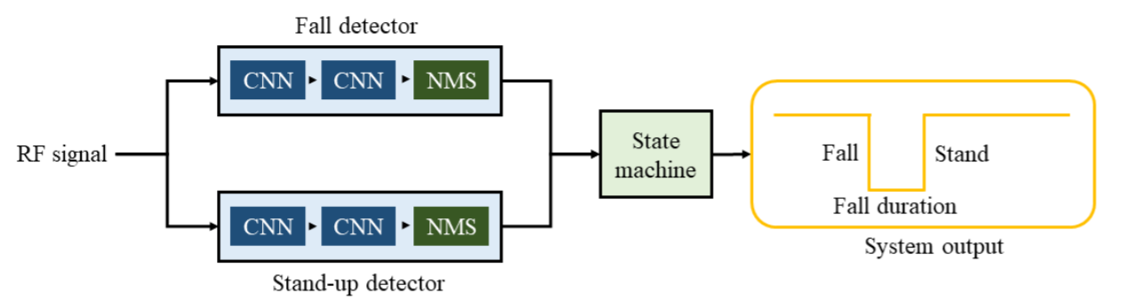

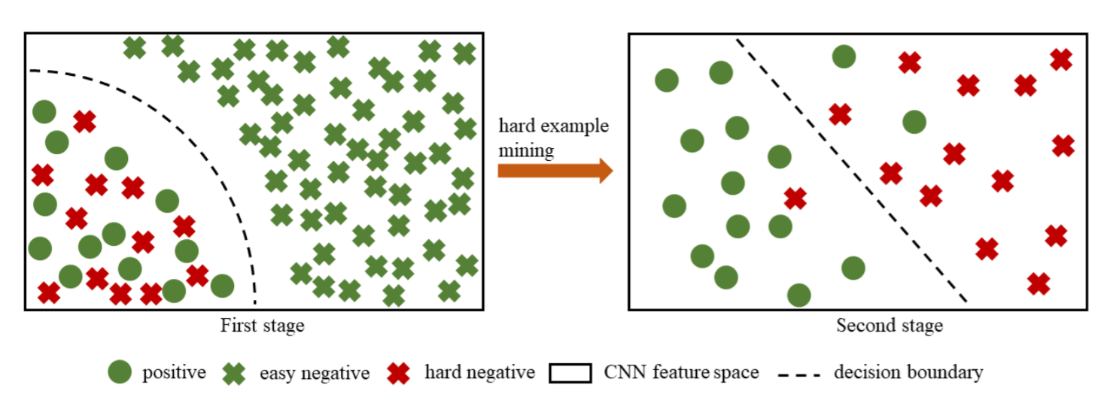


High Level Architecture - Aryokee
No falls (difficult to identify)
No falls (easy to identify)
Falls
Ref: Proc. ACM Interact. Mob. Wearable Ubiquitous Technol., Vol. 2, No. 3, Article 137. Publication date: September 2018.

Slide 7
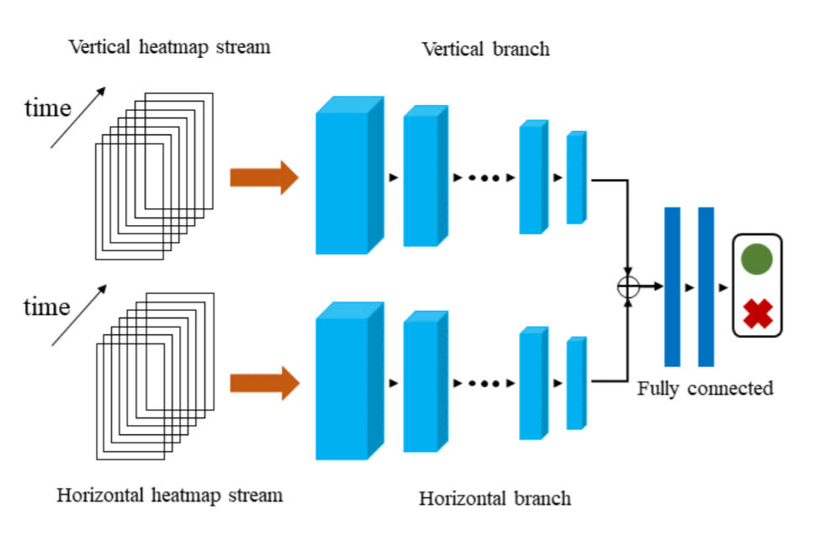


Deep Dive into a single CNN unit
Uses ResNets
10 Layers of 3D conv.
Stride = 2
Why not a SINGLE image with 2 channels?
Gradient Vanishing?
t = 2.5 secs
Softmax
112 heatmaps
10 Layers of 3D conv.
Stride = 2
t = 2.5 secs
112 heatmaps
2-Layer
MLP
Hyperparameters?
Optimizer: Adam
Learning Rate: 0.02
Normalization: Batch Normalization
Kernel Size = 5
Ref: Proc. ACM Interact. Mob. Wearable Ubiquitous Technol., Vol. 2, No. 3, Article 137. Publication date: September 2018.

Slide 8
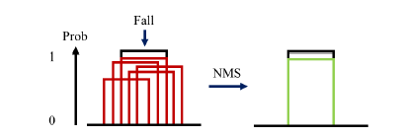
Deep Dive into NMS unit
Single fall can appear in multiple overlapping time windows with different probabilities. NMS chooses the one with highest probability
Ref: Proc. ACM Interact. Mob. Wearable Ubiquitous Technol., Vol. 2, No. 3, Article 137. Publication date: September 2018.

Slide 9
Dataset and Comparison
DATASET
# FALLS
# NON-FALLS
# FALL PATTERNS
# NON-FALL PATTERNS
# PEOPLE
#ENVIRONMENTS
Ours | 541 | 550,000 | 18 | 40 | 145 | 57
Palipana et. al | 326 | 744 | 4 | 8 | 3 | 5
Jovanović et. al | 117 | 291 | 4 | 3 | 3 | 2
GENERALIZATION BEYOND TRAINING SET
 | Precision | Recall
SVM | 17% | 16%
LSTM | 21% | 15%
Cross people and cross environment setting
FallDeFi | 70% | 76%
Aryokee | 92% | 94%

Slide 10
Major achievements of Aryokee
Aryokee generalizes across people and environments
0
100
Generalization
Aryokee works in the presence of other sources of motion
0
100
Other motions
Aryokee deals with complex activities and fall patterns
0
100
Fall Patterns

Slide 11
Gaps Identified; Improvements; Applications
Gaps in the Paper:
Lack of information regarding training time and prediction time
Data was created using a controlled environment
Subjective identification of easy or hard negatives (non-falls)
Suggested Improvements:
Increase the 2-stage Cascading CNN classifier to 3-stage CNN classifier
Computational overhead but performance gain
Commercial viability
Future Applications:
3D ConvNet with time applications
Live Surgery (w/ CT or MRI)
Creature detection based on motion patterns
Weather analysis
Physics

Slide 12
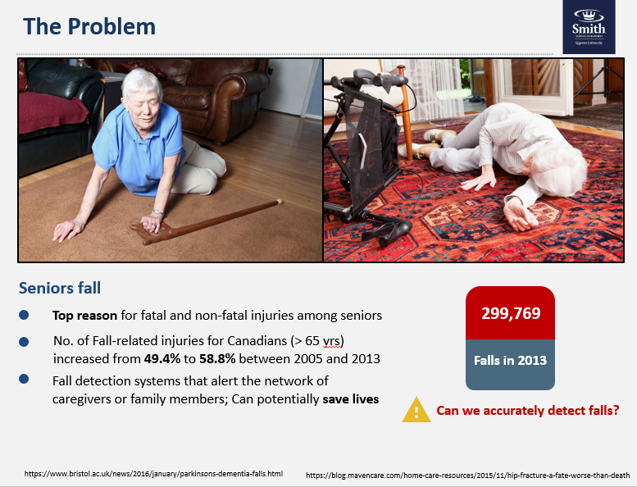
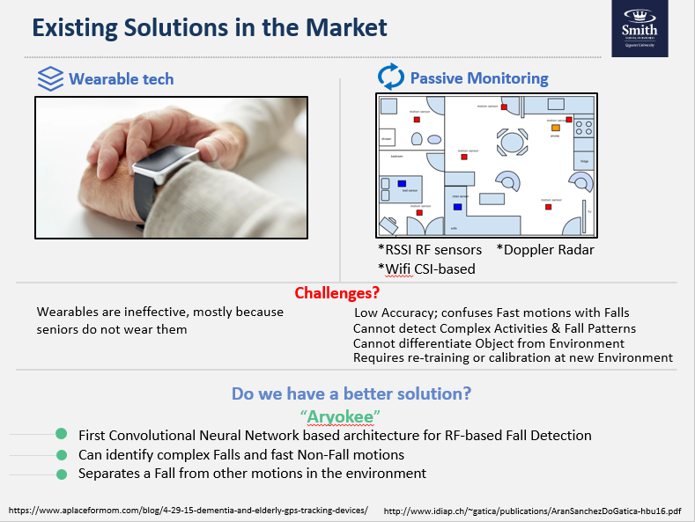
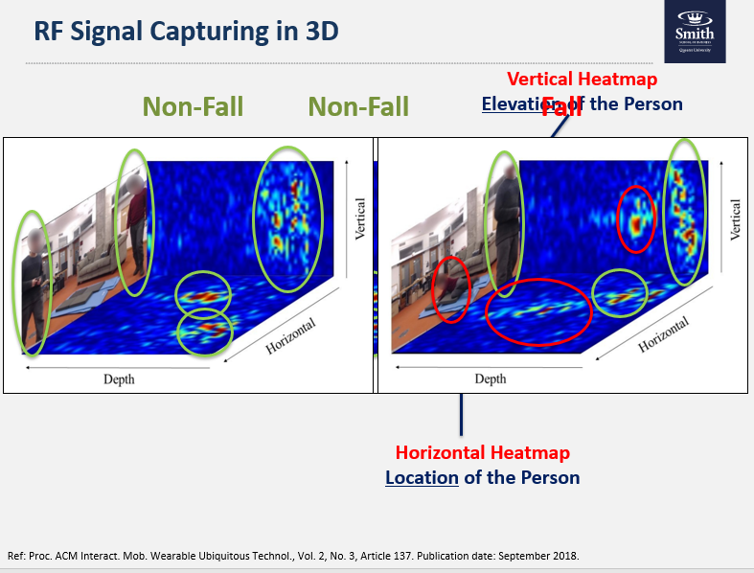
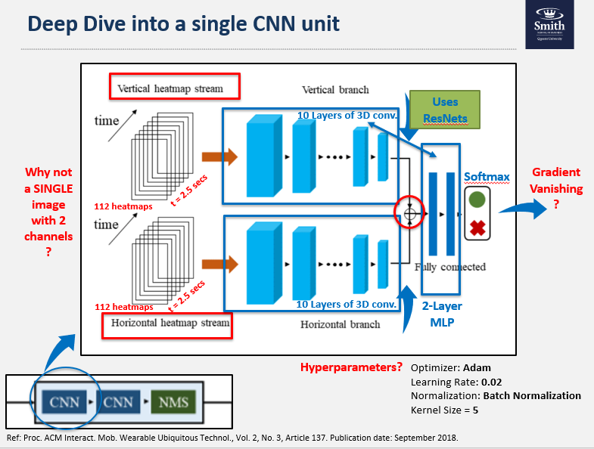
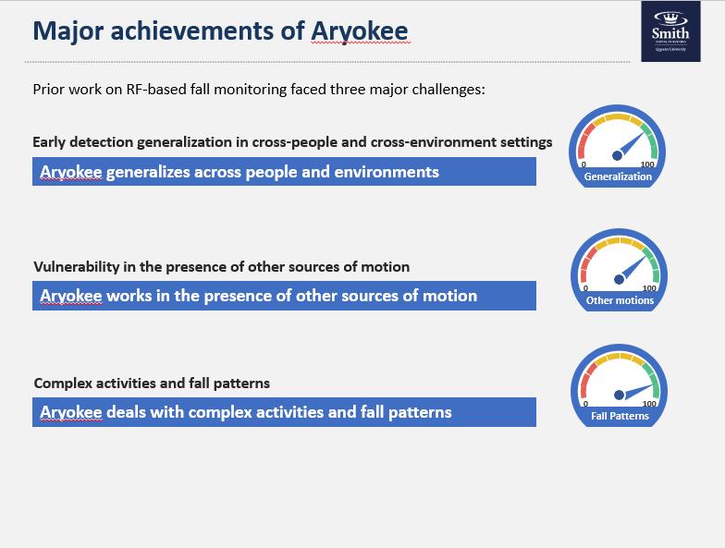
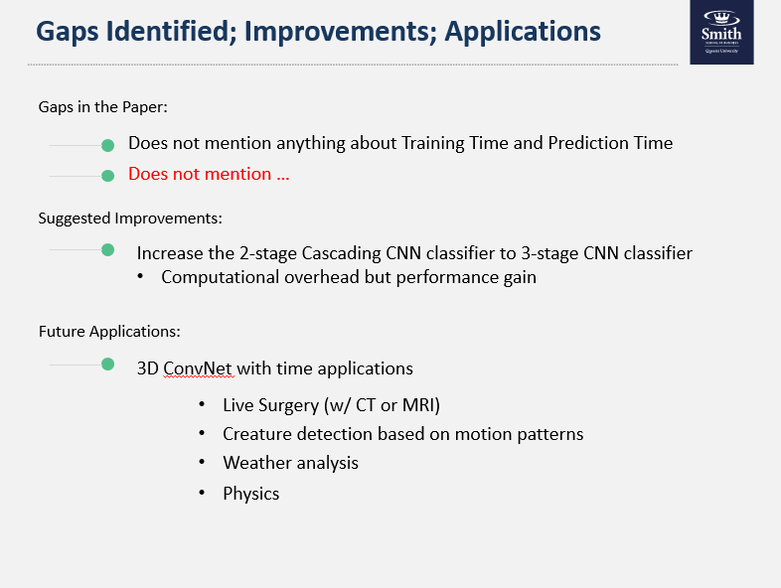
Summary

Slide 13
References
The Paper reference:
Yonglong Tian, Guang-He Lee, Hao He, Chen-Yu Hsu, and Dina Katabi. 2018. RF-Based Fall Monitoring Using Convolutional Neural Networks.
Proc. ACM Interact. Mob. Wearable Ubiquitous Technol. 2, 3, Article 137 (September 2018), 24 pages. https://doi.org/10.1145/3264947
Would like to acknowledge the work of and credit the authors and co-authors of this paper:
YONGLONG TIAN* , Massachusetts Institute of Technology
GUANG-HE LEE* , Massachusetts Institute of Technology
HAO HE* , Massachusetts Institute of Technology CHEN-YU HSU, Massachusetts Institute of Technology
DINA KATABI, Massachusetts Institute of Technology
https://www.ncbi.nlm.nih.gov/pmc/articles/PMC4910457/
https://www.canada.ca/en/national-seniors-council/programs/publications-reports/2017/review-social-isolation-seniors.html
https://www.alzheimer.mb.ca/wp-content/uploads/2013/09/2014-Dementia-Fall-Risk-Checklist-template.pdf

